Slide 1
Multifamily essentials
An Overview of HOME and Housing Credit Programs
January 28, 2016; 9:00am – 11:30am

Slide 2
WELCOME
AHFA Staff/Presenters:
Ketcia Barlow, Multifamily Technician
Dondra Houlditch, HOME Technician
--
Barbara Wallace, Multifamily Manager
Chris Hert, Multifamily Coordinator
ahfa.mf.general@ahfa.com

Slide 3
Introductions
Getting to Know YOU!
Name
Organization (Non-Profit / For Profit) (Role)
Experience in Affordable Housing
What is your interest in attending today?

Slide 4
Session Objectives
Understand:
AHFA’s role in Affordable Housing in Alabama
AHFA Housing Credit Program and Requirements
AHFA HOME Program and Requirements
AHFA Application Cycle
Award Processes and Timelines
AHFA Program Compliance
Success Stories and Development Spotlights

Slide 5
Course Structure
Materials:
Agenda
Resources & Points of Reference
Overheads
AHFA Web Presentation
Intermittent Pop Quizzes for
Prizes

Slide 6
RULES
ASK QUESTIONS
Caveat: Training is focused on AHFA Program Essentials
Keep side conversations to a minimum.
Please turn cell phone ringers and notifications to silent.

Slide 7
AHFA Introduction

Slide 8
What is AHFA?
AHFA was created in 1980 by Act No. 80-585 of the Alabama Legislature. AHFA is a public corporation and instrumentality of the State of Alabama dedicated to serving the housing needs of low- and moderate-income Alabamians. AHFA creates housing opportunities through the affordable financing of single- and multifamily housing.
Since 1980, AHFA had helped more than 105,000 households – serving as Alabama’s affordable housing resource.

Slide 9
AHFA Publications
www.ahfa.com

Slide 10
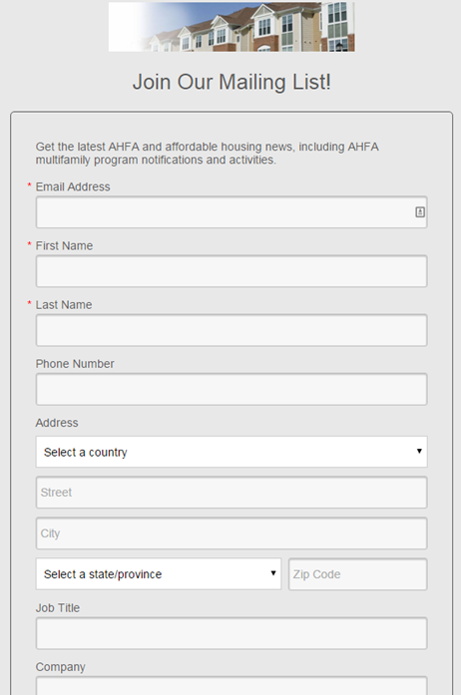
AHFA Publications

Slide 11
AHFA Publications

Slide 12
AHFA Publications

Slide 13
POP QUIZ
Q. In which year was AHFA created by the Alabama Legislature through Act No. 80-585?
A. 1980
Q. Name 3 ways to keep abreast of AHFA news/events:
A1. www.ahfa.com
A2. Join the multifamily mailing list
A3. View annual report or online newsletter (Thresholds)

Slide 14
Housing Credit Overview

Slide 15
Low Income Housing Tax Credit Program (Housing Credit) Overview
Governing Document: Section 42 of the Internal Revenue Code in 1986
The Housing Credit program is the country’s most extensive affordable rental housing program.
Over 2.7 million affordable rental housing units created or preserved.
Provides a place to call home for low- and moderate-income households.
Novogradac, Michael J., CPA. "Exporting the Low-Income Housing Tax Credit." Novogradac, Journal of Tax Credits, June 2015, 4-6.

Slide 16
Housing Credit Overview
Subsidy Program offering an incentive to build affordable housing which can compete in the general marketplace.
Generates approximately 96,000 jobs per year.
Approximately $100 billion in private investment has been leveraged by the program.
Generates $3.5 billion in federal, state and local taxes.
Generates $9.1 billion in economic income.
Novogradac, Michael J., CPA. "Exporting the Low-Income Housing Tax Credit." Novogradac, Journal of Tax Credits, June 2015, 4-6.

Slide 17
Housing Credit Overview
Internal Revenue Service (IRS) allocates funds to states on a per capita basis.
Rates are adjusted annually for inflation
Investors purchase housing credits in qualified properties that have received state award.
Creates cash equity for owners that reduces project development debt burden.
The owner agrees to rent a specific number of units to qualified tenants at specified rents.
Two levels of tax credits are available:
9% Credits for New Construction or Rehabilitation
4% Credits for Acquisition or MultiFamily Bond Financing

Slide 18
Housing Credit Overview
IRS
Generate Housing Credits
AHFA
Award Housing Credits
Applicant / Owner
Apply for Housing Credits

Slide 19
Housing Credit Overview Ownership Requirements
Initial 15-year compliance period
Housing Credits are subject to recapture penalties
Owner (a corporation, nonprofit, or individual) partners with investors (generally a corporation or individual)
Housing Credits are sold to the investors in exchange for cash equity
Investors, usually the Limited Partnership (LP), benefit from the Housing Credits
The Development benefits from the cash infusion received from the sale of Housing Credits
Investors generally transfer the LP interest to the GP at the end of the initial 15-year compliance period

Slide 20
Housing Credit Overview How Housing Credits Work
$800
$400
Notes:
Ms. Jones is on a fixed income, and can afford to pay $400 in rent each month. A new apartment development has been built in a neighborhood where she would like to live, however the owner charges $800 monthly rent. There is no incentive for the owner to rent an apartment to Ms. Jones for $400, when he can rent to someone for $800. Because this owner has incurred debt during construction and now has other expenses (taxes, insurance, management & maintenance) for the property, he must charge Market Rent to recoup his investment.

Slide 21
Housing Credit Overview How Housing Credits Work
$400
Notes:
Those entities that have applied for, and receive a Housing Credit award are able to gain equity through the sale of the housing credits over a 10-year period. The equity gained results in less debt for these owners to repay from rental income. Therefore, the developments can bear a lower rental rate. This results in savings passed to Ms. Jones in the form of a $400 monthly rate.
During the initial 15-year compliance period, in which Housing Credits are subject to recapture, a developer/owner (a corporation, nonprofit, or individual) will usually enter into a limited partnership with investors (generally a corporation or individual) so that it can sell the Housing Credits to the investors in exchange for cash equity. The investors benefit from the Housing Credits while the development benefits from the cash equity.

Slide 22
Housing Credit Overview Restrictive Covenants
Term of Restrictions
Properties developed 1986-1989 had 15-year compliance period.
Properties developed since 1990 have at least 30-year affordability period.
15-year compliance period
15-year extended use period
Additional Extended Use
Restrictions are recorded against the property

Slide 23
Housing Credit Overview Income and Rent Restrictions
An owner must choose one of three occupancy restrictions:
At least 20% of residential rental units shall be rent & income restricted at 50% of AMI*.
At least 40% of residential rental units shall be rent & income restricted at 60% of AMI.
Most applicants select 100% of the rental residential units to be rent restricted at the 60% rent level or less as defined by the rent limits published by HUD and occupied by individuals whose income is 60% or less of the AMI.
*AMI: Area Median Income

Slide 24
POP QUIZ
Q. What is the governing document for the LIHTC Program?
A: Section 42 of the Internal Revenue Code
Q. What are the two levels of tax credits available?
A: 9% credit for New Construction or Rehabilitation
4% credit for Acquisition or Multifamily Bonds
Q. Housing Credits are sold to investors in exchange for what?
A: Cash Equity
Q. Properties developed since 1990 are subject to a 15-year compliance period followed by what?
A: 15-year extended use period
Q. What percentage of rental units do applicants usually select as rent restricted?
A: 100%

Slide 25
HOME Investment Partnerships Program (HOME) Overview

Slide 26
HOME Overview Federal
Governing Agency
US Department of Housing and Urban Development (HUD)
Law:
TITLE II of the Cranston-Gonzalez National Affordable Housing Act
Regulations:
TITLE 24 CFR, Subtitle A., Part 92 – HOME Investment Partnerships Program, Final Rule
TITLE 24 CFR, Parts 5, 91, 92, et al. Affirmatively Furthering Fair Housing; Final Rule
Policy
CPD Notices
Web Source: https://www.hudexchange.info/programs/home/
States are Permitted to Determine How the Program is Administered .

Slide 27
HOME Overview Federal
HOME Program started in 1992
HOME has produced over 1 million units
Congress cut funding 38% in 2012 and imposed tighter restrictions on the Program in FY12 and FY13
HOME Final Rule was published and became effective in 2013
The Affirmatively Furthering Fair Housing Final Rule was published and became effective in 2015
Further cuts to the Program are expected
Notes:
HOME is a federal block grant that provides states and localities with a flexible funding source to meet their diverse affordable housing needs.
States and localities use HOME to finance innovative programs and projects, including new construction, rehabilitation, down payment assistance, and rental assistance – all targeting low to moderate income families.

Slide 28
HOME Overview Participating Jurisdictions (PJs)
State PJ
Alabama Housing Finance Authority
States receive 40% of the total HOME funding
City/County PJs
Localities receive 60% of the total HOME funding based on a formula established by HUD.
Various Housing Programs
Homebuyer
Homeowner
Rental Assistance

Slide 29
HOME Overview Alabama Funding Distribution
40% State Agency
60% Local PJs
Anniston / Calhoun County HOME Consortium
City of Birmingham, Department of Community Development
City of Huntsville, Department of Community Development
Jefferson County Office of Human-Community Services and Economic Development
Mobile County, Grants Department
City of Montgomery, Department of Planning
City of Tuscaloosa, Office of Federal Programs

Slide 30
POP QUIZ
Q. What agency governs the HOME program?
A: US Department of Housing and Urban Development
Q. Who is the state PJ of Alabama’s HOME Program?
A: AHFA
Q. What is the percentage split of Alabama’s HOME funds distributed to the State PJ and Local PJs?
A: 40% to AHFA, 60% to Local PJs

Slide 31
HOME Overview The CHDO Set-Aside
Community Housing Development Organization
Specific type of designation for non-profits
15% of the Annual Allocation is reserved for CHDO projects:
Rental Housing
Reservation = project commitment
92.300 definitions: owned/developed/sponsored

Slide 32
HOME Overview CHDO Certification
Nonprofit must qualify as CHDO
At time of reservation (commitment)
Must meet CHDO definition (92.2) capacity (staff)
Checklist Item | Set-Aside Reservation
1. Legal Structure
2. Independence
3. LI Community Accountability
4. Capacity
5. Role

Slide 33
HOME Overview Federal
HOME provides capital funds, not operating.
There are deadlines for project completion and unit occupancy.
There is a 20 year affordability period.
If requirements are not met, the HOME funds must be repaid.
HOME is a Repayable and Foreclosable Loan – Not a Grant Program

Slide 34
HOME Overview Eligible/Ineligible Uses
Eligible Uses
Acquisition/Site Improvements
New Construction
Project Soft Costs
Ineligible Uses
Non-housing
Non-low-income housing
Shelters
Off-Site Infrastructure
Project Reserves
Public Housing

Slide 35
HOME Overview Federal: Project Timeline
Project Deadlines
Initial Draw: within 12 months of set-up in IDIS
Completion: 4 years* from commitment to completion
Construction Completion and all funds drawn
Occupancy: 18 months to rent all units
*2 years allowed for completion when combined with the Housing Credit Program

Slide 36
HOME Overview Federal: Project Timeline
Project Application
Project Underwriting
CHDO Certification (if CHDO project)
Project Commitment
--
HOME Written Agreement
Project Completion (ready for occupancy)
Environmental Clearance
Full Occupancy
Maximum 4 years*
18 months
*2 years maximum when combined with the Housing Credit Program

Slide 37
HOME Overview Cross-Cutting /Other Federal Requirements
HOME recipients are responsible for all applicable Federal Requirements
Environmental Review
Relocation: URA & HCDA 1974 S. 104(d)
Labor: Davis Bacon (if 12+ units)
EEO, M/WBE, Section 3
Fair Housing & Accessibility: Section 504 & FHAA
www.hudexchange.info/manage-a-program/

Slide 38
HOME Overview HOME Assisted Units - HAUs
Any unit that receives HOME funds is considered HOME assisted.
HOME units are subject to all HOME requirements, (income restrictions, property standards, affordability period, etc.)

Slide 39
HOME Overview Program Compliance - The 5 P’s of Compliance
Statutory cornerstones for HOME Assisted Units
People – income
Price – rent limits
Property – property standards
Period – 20 year affordability period
Policies: process, procedures, paper
Franke, Monte. "HOME Essentials." Lecture, The HFA Institute, J.W. Marriott, Washington D.C., January 10, 2016.

Slide 40
HOME Overview People : Income and Rent Restrictions
An owner must meet the following occupancy restrictions:
At least twenty percent (20%) of the units are rent restricted at or below the fifty percent (50%) rent level with the remaining eighty percent (80%) of the units restricted at or below the sixty percent (60%) rent level or fair market value whichever is less as defined by the rent limits published by HUD.
At least twenty percent (20%) of the units in this project shall be rent restricted and occupied by individuals whose income is fifty percent (50%) or less of the area median income with the remaining eighty percent (80%) of the units to be rent restricted and occupied by individuals whose income is sixty percent (60%) or less of the area median income.
Rent for Units | Income of Tenants
20% of units @ 50% Rent Level | 20% of occupants @ 50% AMI
80% of units @ 60% Rent Level | 80% of occupants @ 60% AMI

Slide 41
HOME Overview Price : Affordability
Rent Limits
HUD publishes annually
All rents adjusted for tenant-paid utility allowances
AHFA must approve rents annually
Limits on fees beyond rent (92.214)

Slide 42
HOME Overview Property : Property Standards
All HAUs must meet property standards to ensure decent & sustainable housing
All HAUs must meet applicable state/local codes (or model codes in absence)
Applicable for the full affordability period
Owners certify annually
Additional HUD standards
Federal requirements (e.g., LBP, accessibility)

Slide 43
HOME Overview Period – Affordability Period
Deed restriction (Land Use Restrictive Covenant)
20 year Affordability period for New Construction Rental
During Affordability Period (reviewed annually):
92.252(f)(2): owners must provide info to PJ.
Certify property standards
92.504(d): on-site sample of files & property inspections.
Within 12 months of completion & every 3* years.
92.504(d)(2): annual financial oversight
*AHFA conducts annual onsite inspections.

Slide 44
HOME Overview Policies: process, procedures, paper
Written Agreements
Unit Mix, occupancy requirements, initial rents, deadlines, affordability start
Affirmative Marketing Plan
Special outreach to those least likely to apply
Tenant Selection Plan
Preferences, selection policies, and procedures for intake, processing, grievances, waitlist
Lease
HUD Lease Addendum* must be included in Tennant Leases
Tenant Participation Plan (CHDOs only)
Fair lease & grievance procedure
Tenant participation in management decisions
*Provided as Addendum to AHFA HOME Written Agreement

Slide 45
POP QUIZ
Q. What are HAUs?
A: HOME Assisted Units
Q. How long is the HOME Affordability Period?
A: 20 Years
Q. What do we refer to as the other federal requirements with which HOME projects must comply?
A: Cross Cutting Requirements

Slide 46
AHFA Program Requirements

Slide 47
AHFA Program Requirements
Housing Credit QAP and HOME Action Plan (Plans)
Application Fees
Threshold Requirements
Developer/Builder Fees
Reservation Requirements
Negative Actions
Point Scoring System
Environmental Policy
Design Quality Standards and Construction Manual
Compliance Monitoring Procedures/Requirements/Penalties
Citizen Participation
Public Hearing
30-Day Comment Period
Approval by AHFA Board of Directors, Governor and HUD

Slide 48
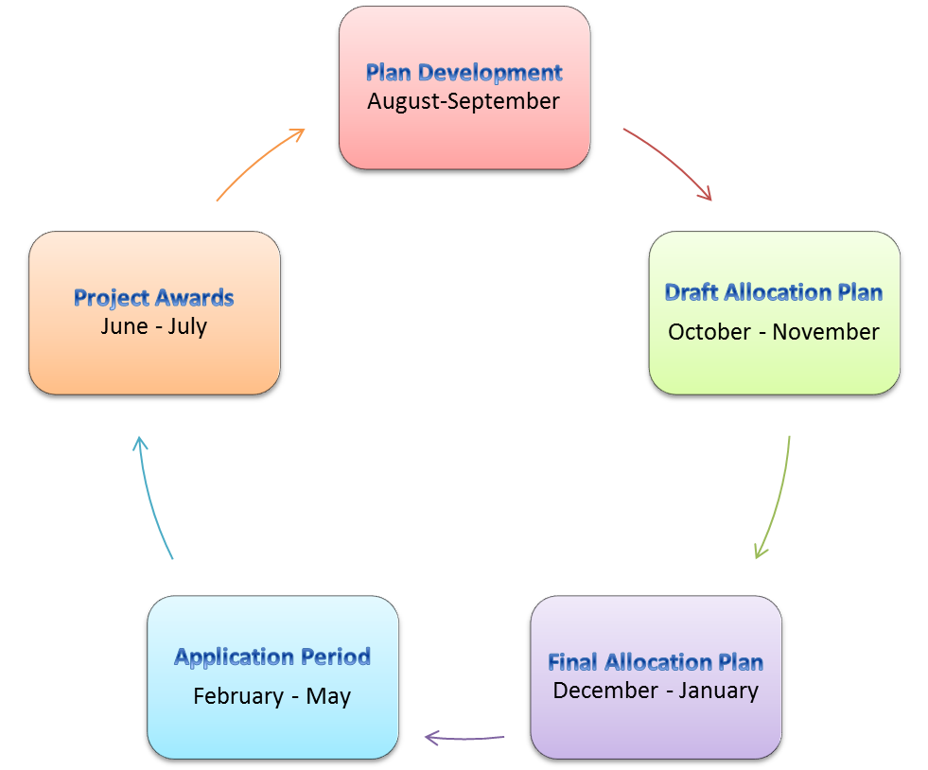
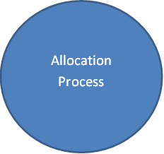
Allocation Cycle

Slide 49
Allocation Cycle

Slide 50
POP QUIZ
Q. Interested persons must read and be familiar with the _______ to understand the program requirements for the Housing Credit or HOME Programs?
A: Plans.
Q. As part of the Allocation cycle, a public hearing is held and citizens can participate in a 30-day __________.
A: Commenting Period

Slide 51
AHFA Housing Credit/HOME Comparison
 | Housing Credit | HOME
2016 Allocation | 11.4 Million | 7.8 Million
Set Aside | Non Profit (10%) | CHDO (15%)
Owner Cap | 12% | 20%
Uses | New Construction Acquisition/Rehabilitation Adaptive Reuse | New Construction
Units | Minimum 12 Maximum based on Owner/Project Cap | Minimum 12 Maximum 56
Income/Rent Restrictions | 100% of units at 60% AMI* 20%/50% 40%/60% Deeper Targeting | 20% of units at 50% AMI 80% of units at 60% AMI
*Area Median Income

Slide 52
AHFA Housing Credit 2016 Estimates
Alabama receives $2.35 per capita x 4,849,377 (state population)
Credit Ceiling $11.4 million
Set-Asides (10% non-profit) $1.1 million
Owner/Project Cap (12%) $1.4 million

Slide 53
AHFA HOME 2016 Estimates
HOME Allocation $7,819,900 million
Loans $5,864,925
CHDO Loans $1,172,985
Administration Fee $ 781,990
Owner/Project Cap $1,563,980 (20%/HOME)
HOME Restrictions Rental
New Construction Only
Non-Participating Jurisdictions

Slide 54
POP QUIZ
Q. Housing credit must set aside _____% for non-profits; whereas HOME must set aside _____% for CHDO.
A: 10% for non profits; 15% for CHDOs
Q. AHFA HOME Funds can be used for ____ __________.
A: New Construction
Q. What is the minimum number of rental units for Housing Credit and HOME funds?
A: 12

Slide 55
Application Cycle Threshold Requirements
Application Fee
Complete Application
Site Control
Proper Zoning
Market Study Analysis
Design Quality Standards and Construction Manual
Flood Certification
Applications submitted in other Participating Jurisdictions
Environmental Site Assessment
Architect’s Certification of Project Progress
Site Location (2-mile radius)
Extended Low-Income Use (5-years)

Slide 56
Application Cycle Initial Application
Application Profile and Initial Application Checklist
Application Fee
Ownership Entity forms
Credit Authorization form
Market Study Certification
Market Study
Electronic copy of Market Study
Environmental Site Assessment Phase I Report

Slide 57
Application Cycle Final Application
Final Application Completeness Checklist
Application Fee
Applicant Self Score Form
Online Application
Statement of Application and Certification
Certification of Bid Law Compliance
Square Footage and Architect Certification
Organizational Documents
Non-Profit Status IRS Letter and Legal Opinion (if applicable)
CHDO Certification Letter (if applicable)

Slide 58
Application Cycle Final Application
Previous Participation Form
Schedule of Real Estate Owned
Relevant Experience Form
Development Team Resume
Identity of Interest
Financial & Credit Statements
Credit Authorization Forms
Other State Activities Form
Owner/Developer Responsibilities Form

Slide 59
Application Cycle Final Application
Management Previous Participation Certification
Management Relevant Experience Form
Management Financial & Credit Statement
2016 Management Verification Letter
Management State Compliance Form
Management Credit Authorization Form

Slide 60
Application Cycle Final Application
Evidence of Site Control
Site/Project Information Form
Neighborhood Services
Negative Neighborhood Services
Location Map with Site and Services
Color photos of site
Color photos of services

Slide 61
Application Cycle Final Application
Registered Historic documentation (if applicable)
Lead Based Paint and Asbestos Testing reports (if applicable)
Utility Letters
Schematic Site Plan
Legal Description
USGS Topographic 7.5 minute Quadrangle Map

Slide 62
Application Cycle Final Application
Zoning Letter
Title Insurance Commitment
Notice of Real Property Acquisition
Certified Survey
Surveyor’s Certification
Census Tract Verification Letter
Utility Allowance Documentation

Slide 63
Application Cycle Final Application
Construction and Permanent Commitment Letters
Certification of Consistency with Consolidated Plan (if applicable)
Architect Certification of Project Progress
Notice to Tenants Concerning Relocation/Displacement
Tenant Roll

Slide 64
Application Cycle Final Application
Commitment Letters for Additional Subsidies
Public Housing Authority Certification
AHFA 2016 Application Workshop Certificate
Census Tract Verification for Median Family Income
Evidence of Previously existing multifamily housing
Minority or Women-Owned Business Certification

Slide 65
Application Cycle Final Application
Community Revitalization Plan Pages
Homeownership Conversion Proposal

Slide 66
Application Cycle Final Application
Support Letters
Complete copy of final application
One additional copy of specified documents

Slide 67
Application Cycle Online Application
Registration in DMS
Affiliate Development Team Organizations
Complete all Forms before beginning online application
DMS Overview

Slide 68
POP QUIZ
Q. Name (2) Threshold Requirements for applications must meet when applying for AHFA Housing Credits or HOME funds?
A. Application Fee, Complete Application, Site Control, Proper Zoning, Market Study Analysis, adherence to DQS & Construction Manual, Flood Certification, Applications submitted in other PJs, ESA, Architect’s Certification, Site Location, Extended Use.
Q. The application process includes the initial application, online application and _________ application.
A: Final
Q. To complete on online application, you must register in ________?
A: DMS

Slide 69
Team Building Organizational Roles
Seek experienced partners
Joint Venture with successful organizations
Cash Reserves are a must
Seek Risk Averse Investors

Slide 70
Keys to Success
Read the PLANS, Application Instructions, etc. in entirety.
Sign Up for Constant Contact Notices
Thoroughly Check Application Prior to Submitting (QA/QC)
Partnering with Experienced Developers

Slide 71
POP QUIZ
Q. Besides joint venture, cash reserves, and risk aversity, a good characteristic to have as a project owner or developer is ___________.
A: experience
Q. A Key to Success is to read the _______ & ____________ in their entirety.
A: Plans; Application Instructions

Slide 72
Application Cycle Timeline
Preliminary Applications due in February
AHFA HOME/Housing Credit Workshop February
Final Application due in March
Award Announcements in June

Slide 73
Why Affordable Housing?

Slide 74
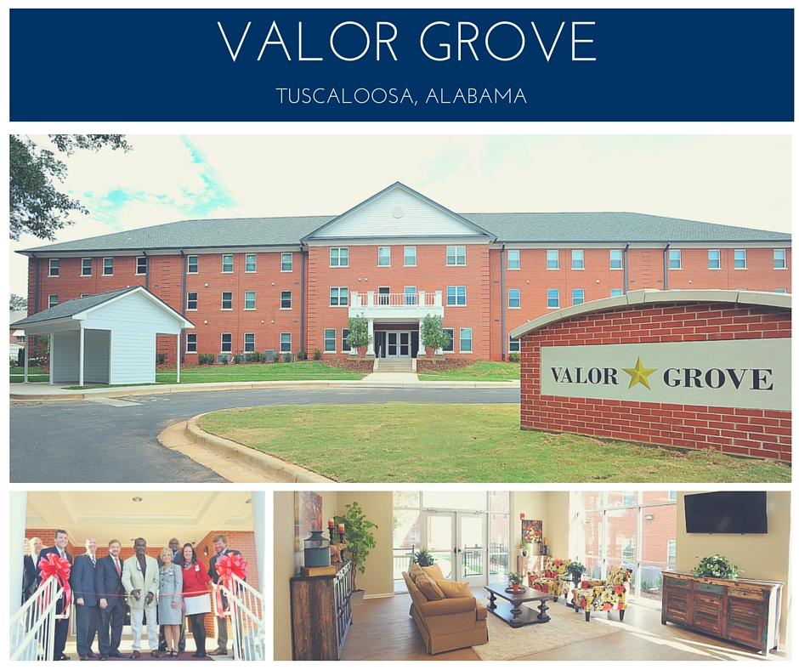
Why Affordable Housing?
Valor Grove
50 Units
New Construction
Received Housing Credits in 2012
Veteran’s Focus Project
Amenities/Tenant Services:
Community Room with Cable TV and Wireless Internet
Exercise/Fitness Room
Covered Bus Stop Shelter
Gazebo
Picnic Area with Grills
Community Laundry
Washer/Dryer Connections in units
Dishwashers in Units
Microwave Ovens in Units
Ice Makers & Disposals

Slide 75
Why Affordable Housing?
Pinecrest Apartments
36 Units
For the Elderly
Rehabilitation Project
Originally received Housing Credits in 1993
Rehabilitation Project:
Part of an innovative solution to rehabilitate 13 properties in Alabama
Project was featured in the national Novogradac Journal of Tax Credits.
Created more modern, energy-efficient homes for residents
Notes:
After a recent rehabilitation effort at Pinecrest, Jeanette Simmons and Brenda McCarthy love living at Pinecrest even more. Simmons said, “I live in a handicap apartment, and if I ever get in a wheelchair, I’m able to get in and out now. I got a microwave that’s easier for me to reach, we got nice floors, and the bathtub is a safety tub so I can sit down and shower. They made everything really convenient for me.” McCarthy said, “While the rehab was going on, we had to move around a lot of our stuff and get up early some mornings. It was a little inconvenient, but it was very much worth it for all that we got.”
To read more of Jeanette and Brenda’s story, visit: http://www.ahfa.com/news/success_stories.aspx.

Slide 76
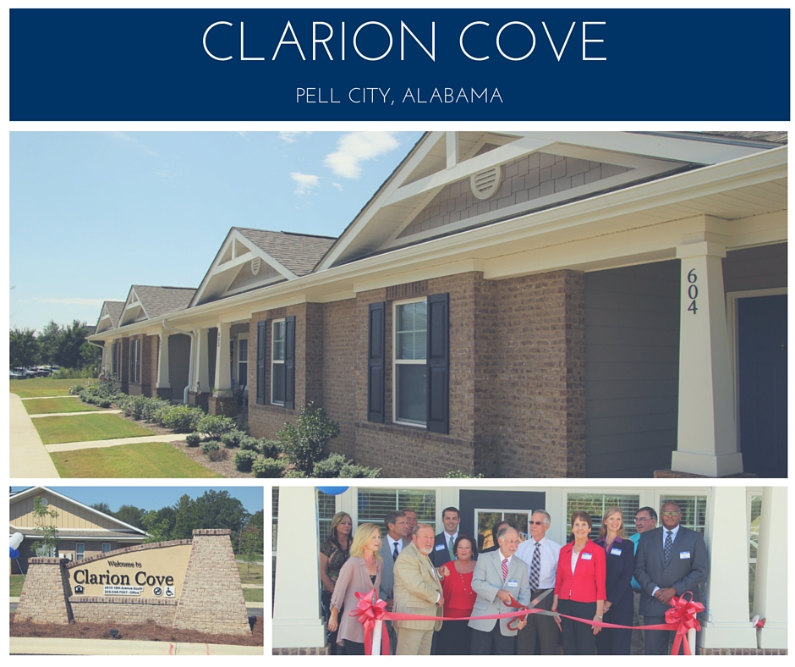
Why Affordable Housing?
Clarion Cove
60 Units
New Construction
Received Housing Credits in 2013
Multifamily Project
Amenities/Tenant Services:
Clubhouse with Cable TV & Wireless Internet
Computer Center
Playground
Picnic Area with grills

Slide 77
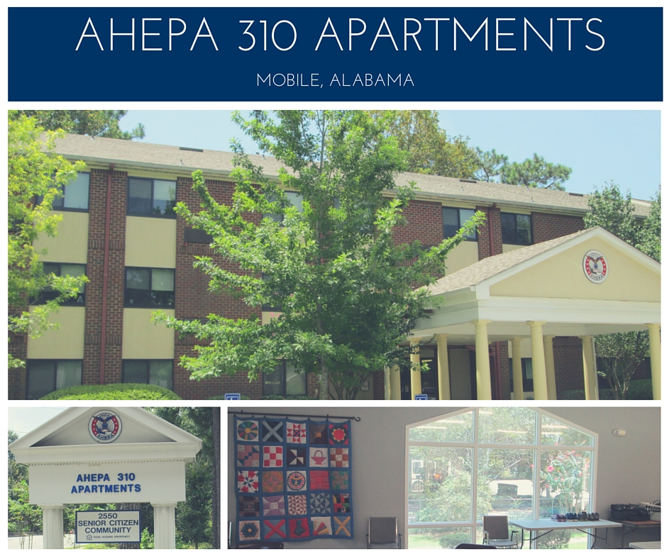
Why Affordable Housing?
AHEPA 310 Apartments
96 units
Received Bond Funds in 2013 & Housing Credits in 2015
For disabled residents & elderly aged 62 and older
Amenities/Tenant Services:
Shuttle service to stores, pharmacies, social outings, etc.
Supportive service coordinator works as a personal guide to resources
Business centers w/computers
Libraries
Exercise rooms
Community rooms
Walking path
Notes:
AHEPA 310 I and AHEPA 310 II were initially developed as HUD-subsidized Section 202 housing developments in 1985 and 1986. In 2013, the properties were refinanced under one mortgage to become AHEPA 310 Apartments. Housing Credits enabled a recent renovation, restoring the property's beauty and adding new amenities for residents.
Thirty years ago, the original residents made a quilt that each contributed an individual square to, many signing and dating their squares. The quilt continues to hang in the main community room for all to see and appreciate.

Slide 78
Why Affordable Housing?
Baytown Senior Village
48 Units
New Construction
Received HOME Funds and Housing Credits in 2013
Senior Community Project
Amenities/Tenant Services:
Clubhouse with Cable TV & Wireless Internet
Computer Center
Exercise/Fitness Center
Gazebo
Covered Bus Stop/Shelter
Picnic Area with grills
Emergen

Slide 79
Why Affordable Housing?
The Village at Oliver Place
24 Units
New Construction
Received Housing Credits and HOME Funds in 2013
CHDO Project
Amenities/Tenant Services:
Outside Gazebo
Grill & Picnic Area w/Playground
Community Building: Wireless Internet, Community Cable TV, laundry, exercise room, computer room
Offers Financial Capability Workshop
Notes:
Barry Cleghorn and his family moved from Madison to Phil Campbell in 2012 to live with and care for his wife’s ailing grandmother. Since she has transitioned to assisted living, the Cleghorns are now trying to sell the home to pay for her continued medical care and other living expenses. That left them in need of a place of their own. On a drive around town, they saw the eye-catching, attractive apartments at The Village at Oliver Place. Cleghorn says his wife, “Turned in on two wheels. We came back two weeks later and had a tour and were just blown away, but we didn't think we could ever afford it." When they moved to Phil Campbell, Cleghorn says he knew the pace of life was going to be very different. He says, “It's amazing the difference between industry in the Madison/Huntsville area and Phil Campbell. Although he says, “I get some work here and there, and my wife was fortunate to find a good job in the area,” the affordable rent at The Village at Oliver Place was just what they needed. The development is one example of Phil Campbell continuing its recovery from the devastating April 2011 tornadoes that destroyed much of the town. The Community Action Partnership of North Alabama built The Village at Oliver Place to provide high-quality housing that is also affordable for the people in the Phil Campbell area, in particular, those displaced by the tornadoes. The Partnership is a nonprofit with a fifty-year history of achieving its mission of reducing or eliminating the causes and consequences of poverty for families and communities. Michael Tubbs, CEO of the Partnership, said, "I think this is one of the most beautiful developments we’ve ever done, and it’s something the community can really be proud of. We wanted it to have a community feel, and we were intentional in our design to make sure that’s the way it turned out.” The Village at Oliver Place opened in January 2015 and has an outside gazebo, grill and picnic area with a playground, and a community building that features wireless Internet, community cable TV, laundry facility, exercise room, and computer room. There are 12 two-bedroom units and 12 three-bedroom units. Two of the two-bedroom units are handicap accessible. Funding for the $4.3 million development came from multiple sources. AHFA allocated more than $324,000 in Housing Credits and more than $580,000 in HOME funds to the development. The developers also received funding from a community development block grant and private investors. In addition to building The Village at Oliver Place, the Partnership has provided a Financial Capability workshop to residents. This training is regularly offered in north Alabama, but they have hosted the workshop in Phil Campbell as well. It is a multi-week course for anyone who may need credit repair, better practice managing their income, and help figuring out how to get their financial house in order. Since the day they moved in, the Cleghorns have been in love with The Village at Oliver Place, including their nine-year-old adopted daughter Ali. Ali was formerly their foster child, and had 17 placements before coming to live with the Cleghorns, which left her with an attachment disorder. Their home is also home for her service animal that helps her with those issues, a black pug named Gus. Cleghorn says, "If you meet her now, you could never tell she had any issues. She's so polite, sweet, and well adjusted. She's on the A/B honor roll. We're very proud of her and lucky to have her." While the family isn't planning to foster any more children for a while, Cleghorn says they may look into doing some respite or shorter-term care. If they do, they have plenty of space, which is one of the things they enjoy most about their home. "We love the space, layout, upstairs area - it just suits our needs perfectly. We appreciate this place and love it," Cleghorn says.

Slide 81
Questions

Slide 82
Sources and Resource Sites

Slide 83
Sources
"LIHTC 101: The Basics Workshop." Proceedings of Novogradac Affordable Housing Tax Credit Conference, Roosevelt Hotel, New Orleans, LA. September 30, 2015
"2016 HOME ACTION PLAN - Alabama Housing Finance Authority." Accessed January 26, 2016. http://www.ahfa.com/sites/www/Uploads/files/MF Allocation/2016 HOME Action Plan DRAFT.pdf.
"2016 HOUSING CREDIT QUALIFIED ALLOCATION PLAN - Ahfa.com." Accessed January 26, 2016. http://www.ahfa.com/sites/www/Uploads/files/MF Allocation/2016 QAP.pdf.
Franke, Monte. "HOME Essentials." Lecture, The HFA Institute, J.W. Marriott, Washington D.C., January 10, 2016.
HOME Final Rule, § 24 CFR-Part 92 (2013).
Low-Income Housing Credit, § 26 CFR-42.
Novogradac, Michael J., CPA. "Exporting the Low-Income Housing Tax Credit." Novogradac, Journal of Tax Credits, June 2015, 4-6.
Title II of the Cranston-Gonzalez National Affordable Housing Act, § Subpart A - HOME Investment Partnership.

Slide 84
Resource Sites
Alabama Housing Finance Authority (AHFA) – www.ahfa.com
Alabama Department of Economic & Community Affairs (ADECA) – www.adeca.alabama.gov
Alabama Affordable Housing Association (AAHA) – www.theaaha.org
HUD Exchange (US Department of Housing and Urban Development) – www.hudexchange.info/programs/home
Novogradac & Company, Tax Credit Resource Center - www.novoco.com/resource_center/index.php

